Slide 1
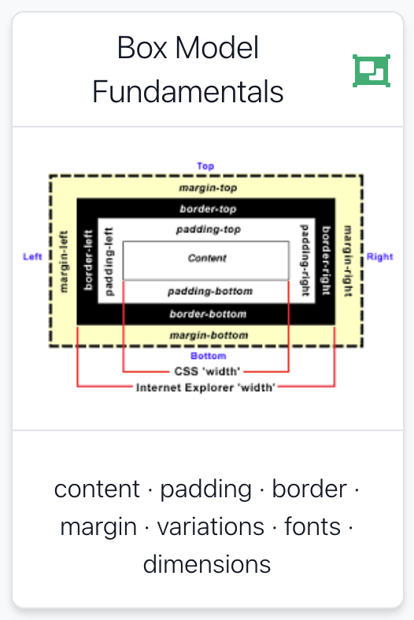
Notes:
The box model was introduced in 1996 after margin, border and padding were added to more elements. Before HTML 4 and CSS, very few HTML elements supported both border and padding, so the definition of the width and height of an element was not very contentious. However, it varied depending on the element.
After 1996, CSS adopted a definition of width in relation to content, border, margin, and padding similar to a table cell. This has since become known as the W3C box model. Since the release of CSS3, it is now referred to as the content-box. According to the CSS1 specification, released by W3C in 1996 and revised in 1999, when a width or height is explicitly specified for any block-level element, it should determine only the width or height of the visible element, with the padding, borders, and margins applied afterward.

Slide 2
Agenda
Box Model
Box Model: Content, Padding, Border & Margin
Background images
Border Styles, Width, Colour
Notes:
The box model was introduced in 1996 after margin, border and padding were added to more elements. Before HTML 4 and CSS, very few HTML elements supported both border and padding, so the definition of the width and height of an element was not very contentious. However, it varied depending on the element.
After 1996, CSS adopted a definition of width in relation to content, border, margin, and padding similar to a table cell. This has since become known as the W3C box model. Since the release of CSS3, it is now referred to as the content-box. According to the CSS1 specification, released by W3C in 1996 and revised in 1999, when a width or height is explicitly specified for any block-level element, it should determine only the width or height of the visible element, with the padding, borders, and margins applied afterward.

Slide 3

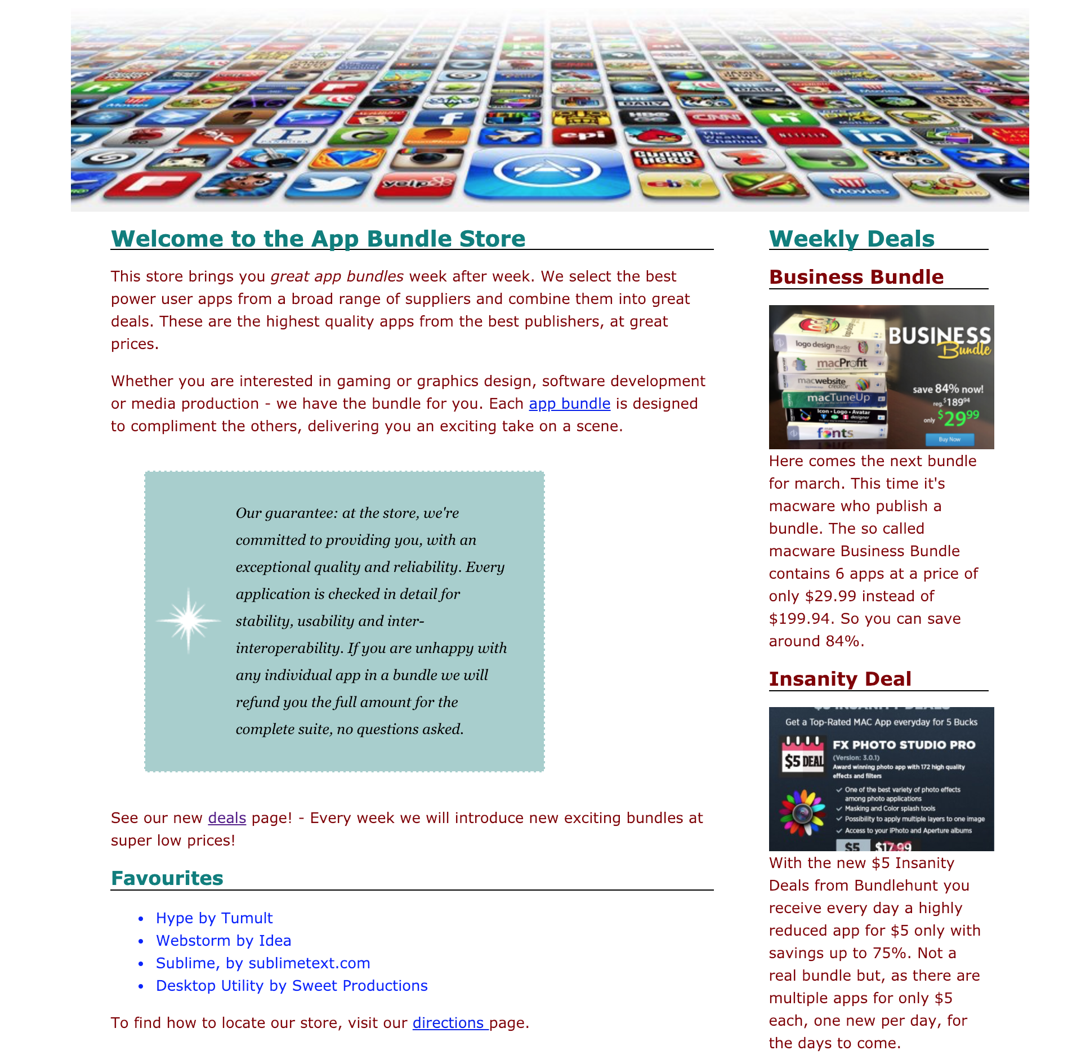

Slide 4
body {
font-family: Verdana, Helvetica, Arial, sans-serif;
font-size: small;
line-height: 1.6em;
}
h1, h2 {
color: #007e7e;
border-bottom: 1px solid black;
}
h1 {
font-size: 150%;
}
h2 {
font-size: 130%;
}
p {
color: maroon;
}
Notes:
All designed in code, no WYSYUG editor

Slide 5

body {
font-family: Verdana, Helvetica, Arial, sans-serif;
font-size: small;
line-height: 1.6em;
}
h1, h2 {
color: #007e7e;
border-bottom: 1px solid black;
}
h1 {
font-size: 150%;
}
h2 {
font-size: 130%;
}
p {
color: maroon;
}

Slide 6
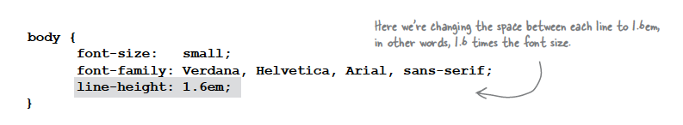
line-height
Increasing the line height of your text can improve readability. It also gives you another way to provide contrast between different parts of your page.
Fonts can be measured in absolute for relative terms:
Absolute:
px - Pixels, absolute, screen oriented
pt - Points, absolute, print oriented
Relative
em – 1em = the size of the elements “current” font
rem – 1 rem = the size of the
vw - 100 vw = the full width of the viewport
% - 100% = the size of the elements “current” font
https://css-tricks.com/css-font-size/

Slide 7
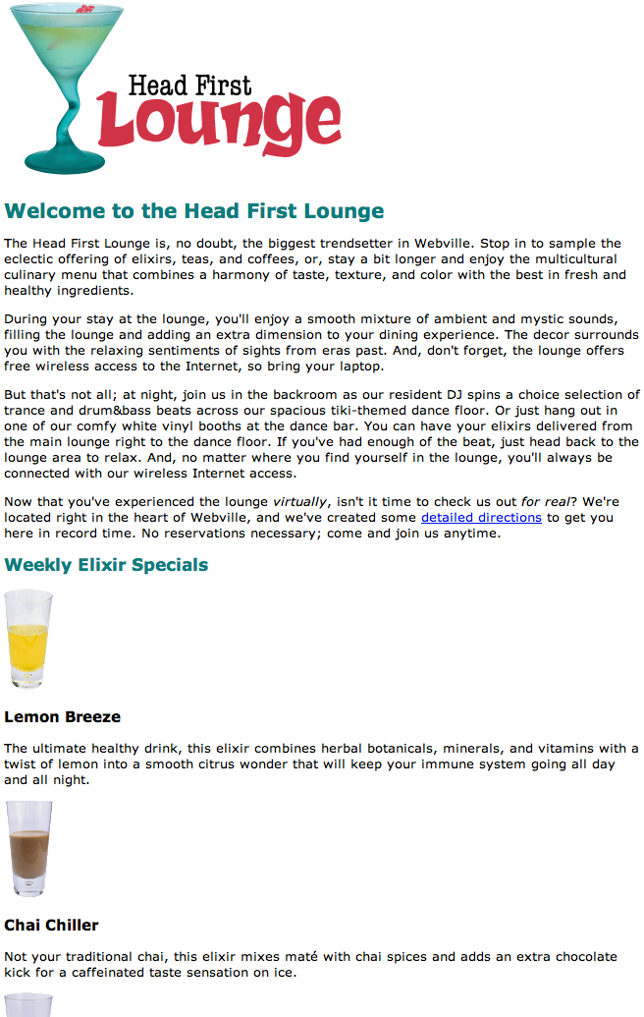
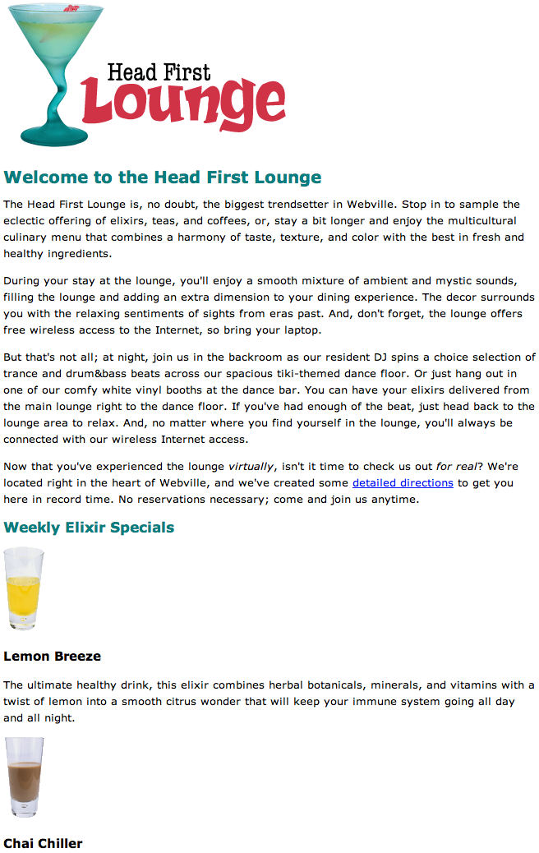

Slide 8
Relative vs Absolute
Relative Dimensions
Use relative units when you want your design to be flexible and adapt to different screen sizes.
Ideal for responsive layouts where elements should scale proportionally.
Helpful for accessibility, allowing text and other elements to scale based on user preferences.
Absolute Dimensions:
Use absolute units when you need precise control over the size of an element.
Suitable for elements with fixed sizes, such as images or containers with specific layout requirements.
Useful for print stylesheets where physical dimensions may be more relevant.

Slide 9

Relative vs Absolute
Typically, a combination of both relative and absolute is used and really does depend on the content that is to be displayed.
There is rarely a very simple answer.

Slide 10
Relative vs Absolute
Relative dimensions are typically used in the realm of responsive designs…..
Responsive web design (RWD) or responsive design is an approach to web design that aims to make web pages render well on a variety of devices and window or screen sizes from minimum to maximum display size to ensure usability and satisfaction

Slide 11
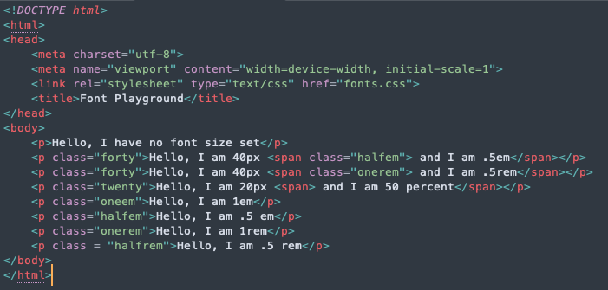
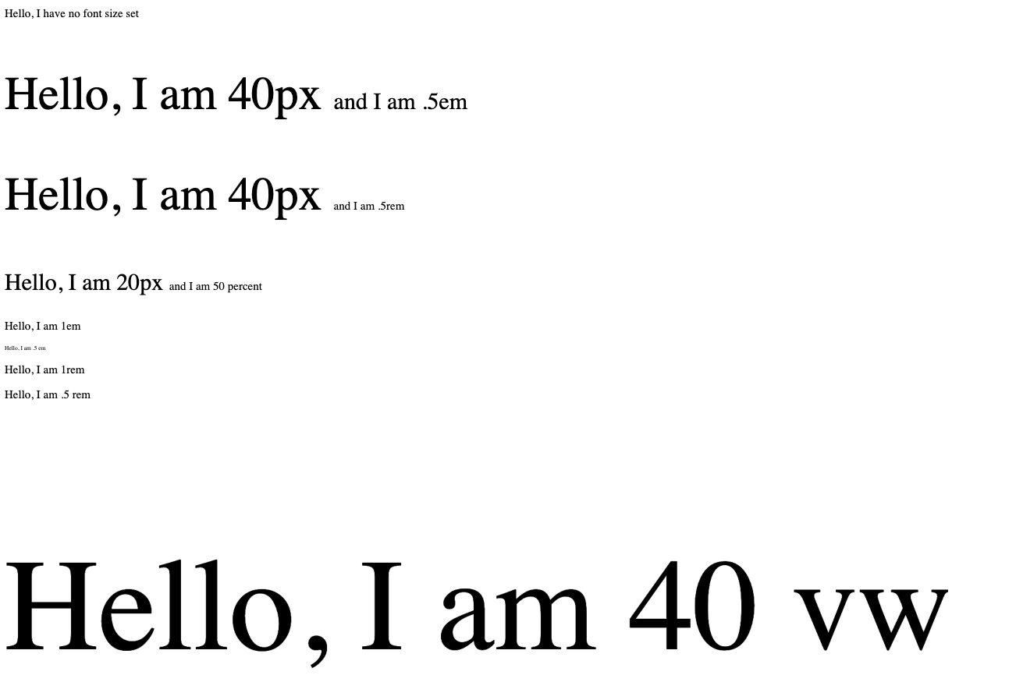
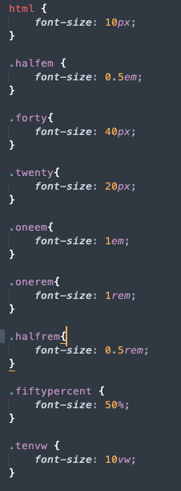

Slide 12
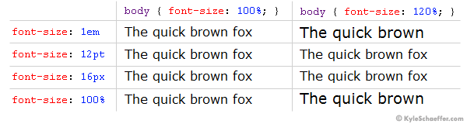
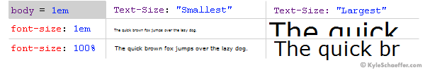
Are % and em the same?
A lot of the time % and em behave the same
When the client’s browser text size is set to “medium,” there is no difference between ems and percent.
When the setting is altered, however, the difference is quite large.
On the “Smallest” setting, ems are much smaller than percent, and when on the “Largest” setting, it’s quite the opposite, with ems displaying much larger than percent. While some could argue that the em units are scaling as they are truly intended
In practical application, the em text scales too abruptly, with the smallest text becoming hardly legible on some client machines.
https://kyleschaeffer.com/css-font-size-em-vs-px-vs-pt-vs-percent

Slide 13
Let confusion sink in……

Slide 14
CSS Box Model
Boxes consist of:
Content
Padding
Border
Margin
So far, your CSS has focussed on changing simple properties of elements, like size and color. For effective layout control, you have got to move on to the box model.
The box model is how CSS sees elements.
CSS treats every single element as if it were represented by a box.
All elements are treated as boxes: paragraphs, headings, block quotes, lists, list items, and so on. Even inline elements like <em> and links are treated by CSS as boxes

Slide 15
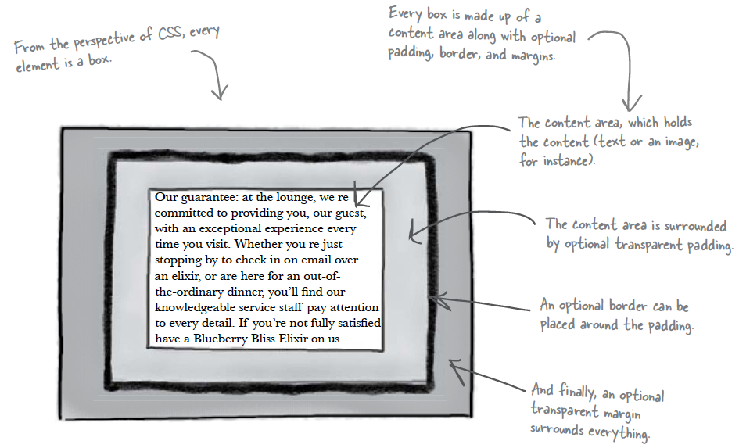

Slide 16
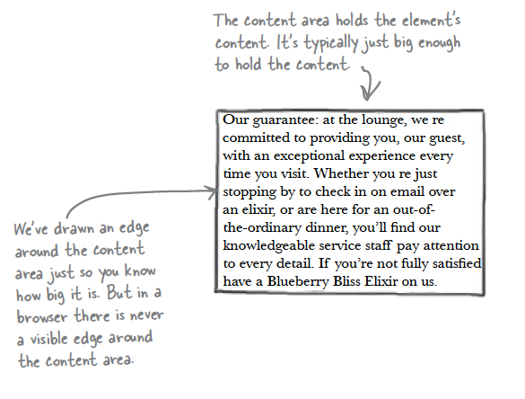
Content Area
Every element starts with some content, like text or an image, and this content is placed inside a box that is just big enough to contain it.
The content area has no whitespace between the content and the edge of the box

Slide 17
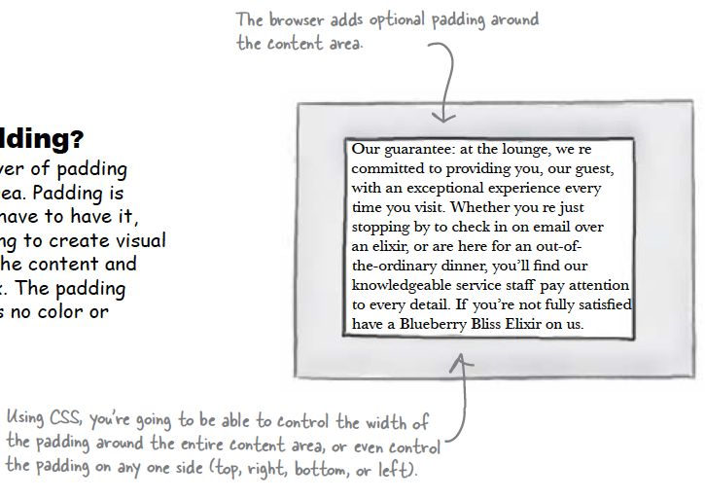
Padding
Any box can have a layer of padding around the content area.
Padding is optional, so you don’t have to have it, but you can use padding to create visual whitespace between the content and the border of the box.
The padding is transparent and has no color or decoration of its own.

Slide 18
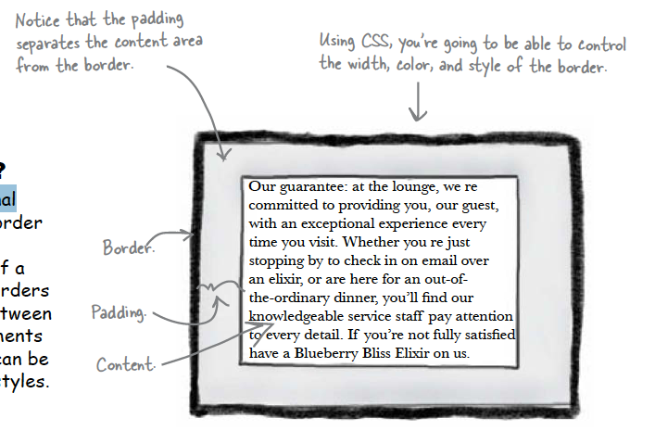
Border
Elements can have an optional border around them
The border surrounds the padding and because it takes the form of a line around the content, borders provide visual separation between content and other elements on the same page
Borders can be various widths, colors and styles

Slide 19
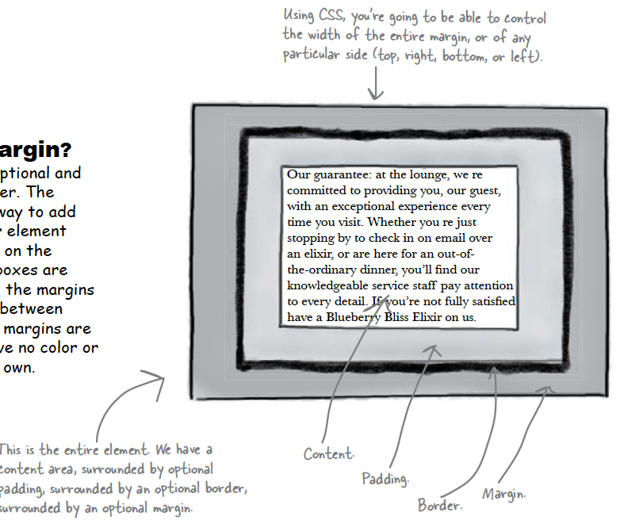
Margin
The margin is also optional and surrounds the border.
The margin gives you a way to add space between your element and other elements on the same page.
If two boxes are next to each other, the margins act as the space in between them.
Like padding, margins are transparent and have no color or decoration of their own.

Slide 20
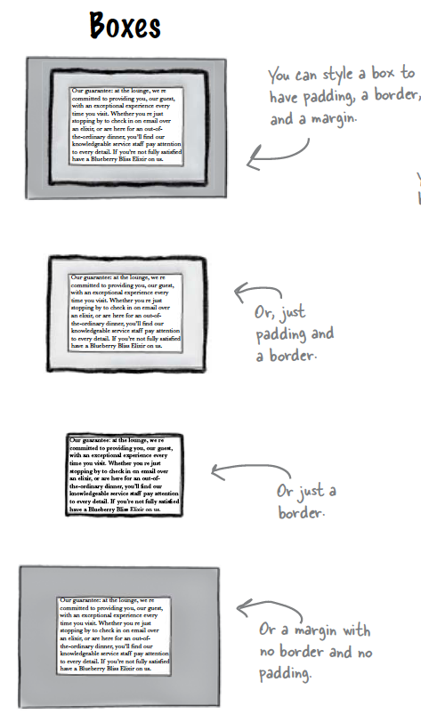
Variations: Boxes
The box model may look simple with just the content, some padding, a border, and margins.
But when you combine these all together there are endless ways you can determine the layout of an element with its internal spacing (padding) and the spacing around it (margins).

Slide 21
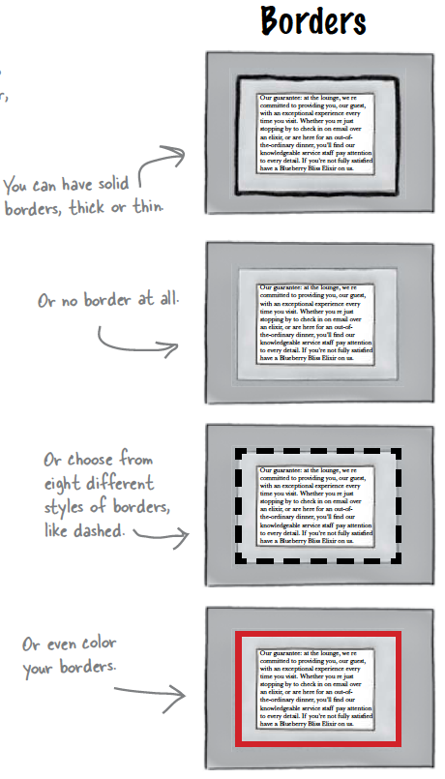
Variations: Borders

Slide 22
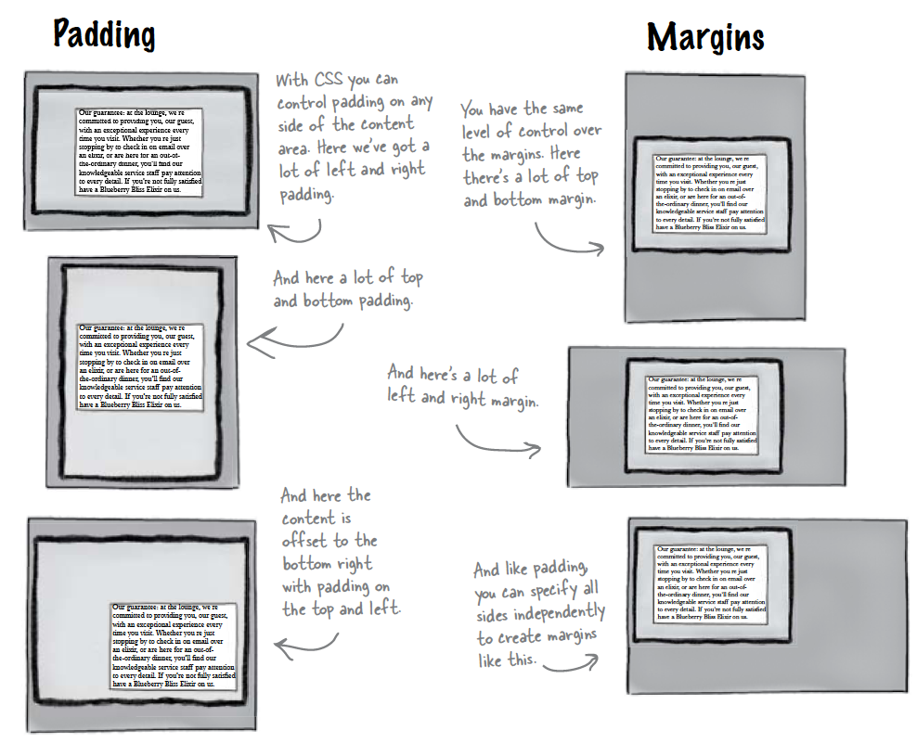
Variations: Padding & Margins

Slide 23
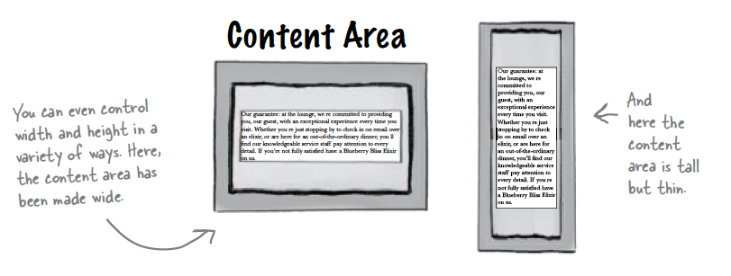
Variations: Content

Slide 24
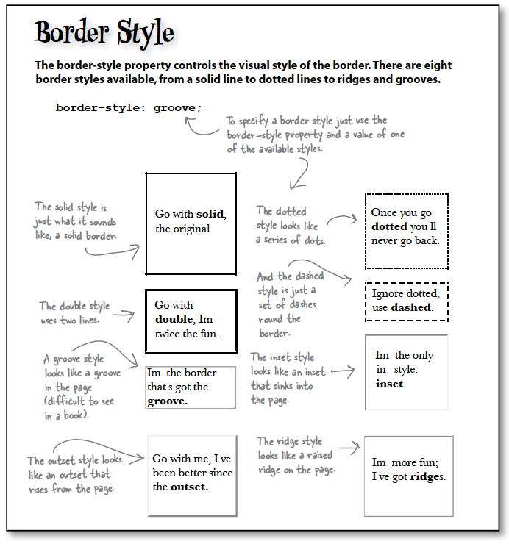

Slide 25
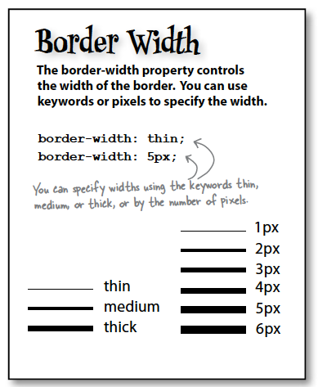
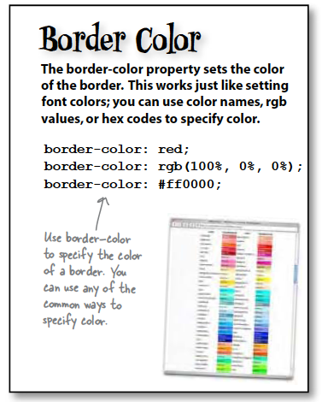

Slide 26
